Slide 1
UEEE Network Technologies
Background
Overview
Staff
Examples
Comparison

Slide 2
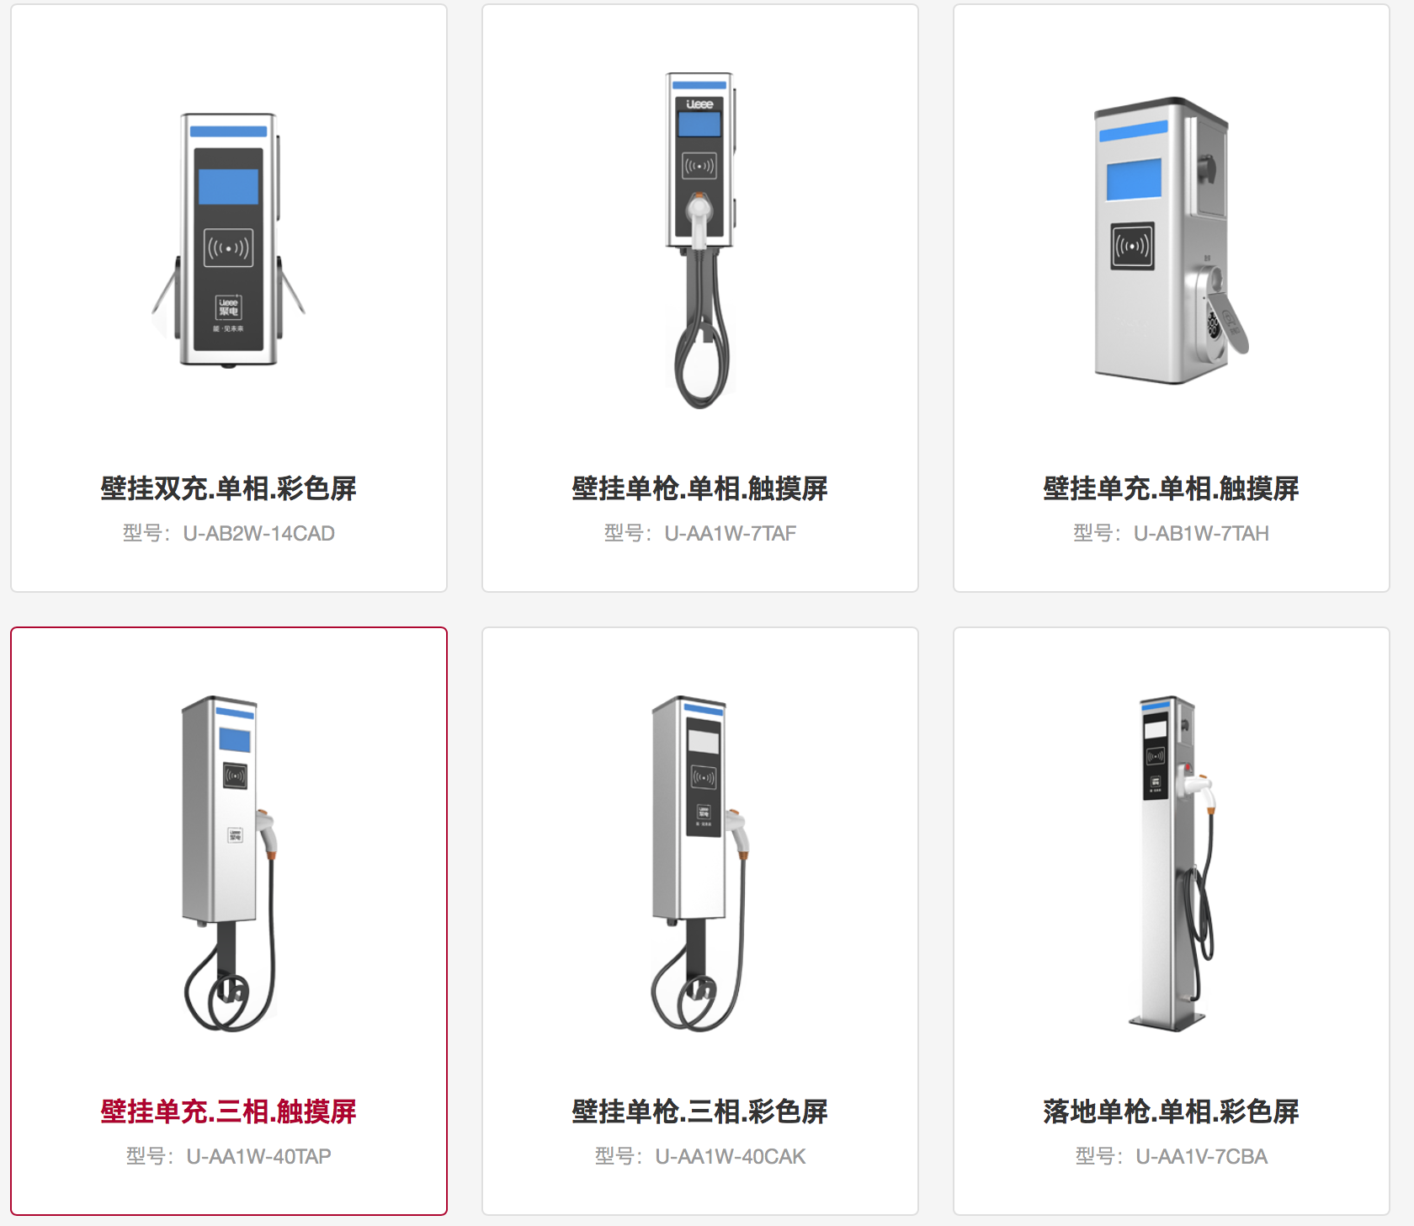
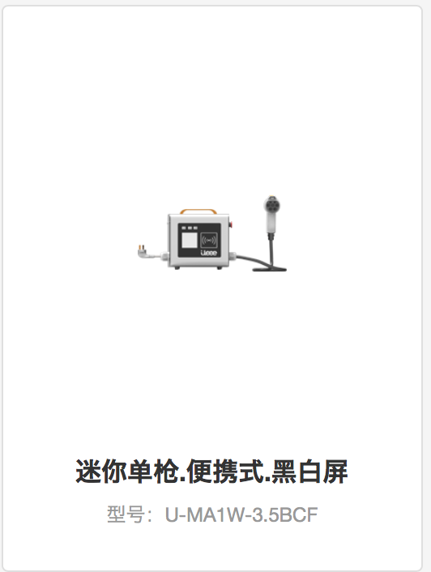
China Charging Stations Background
AC power charge:
3.5kW AC220V
7.0kW AC220V
40 kW AC380V
DC power charge:
15 kW, 30 kW, 45 kW, 60 kW, 90 kW, 120 kW, 180 kW, 240 kW, 360 kW DC380V
Wall type, Stand (floor) type, mini (carriable) type

Slide 3

UEEE Netork Technologies Co., Ltd.
UEEE Network Technologies Co., Ltd. is a comprehensive EV service supplier, covering charging piles manufacture and sale, charging station construction, as well as smart charging network with software management system(mobile apps). It’s awarded one of the“Ten Best charging equipment manufacturers and service provider.” (http://www.sohu.com/a/122799259_389337)
UEEE develops charging pile equipment for EV. It offers varies types, including floor with base type single/double charge, wall-mounting type single/double charge, mini wall-mounting type single/double charge.

Slide 4
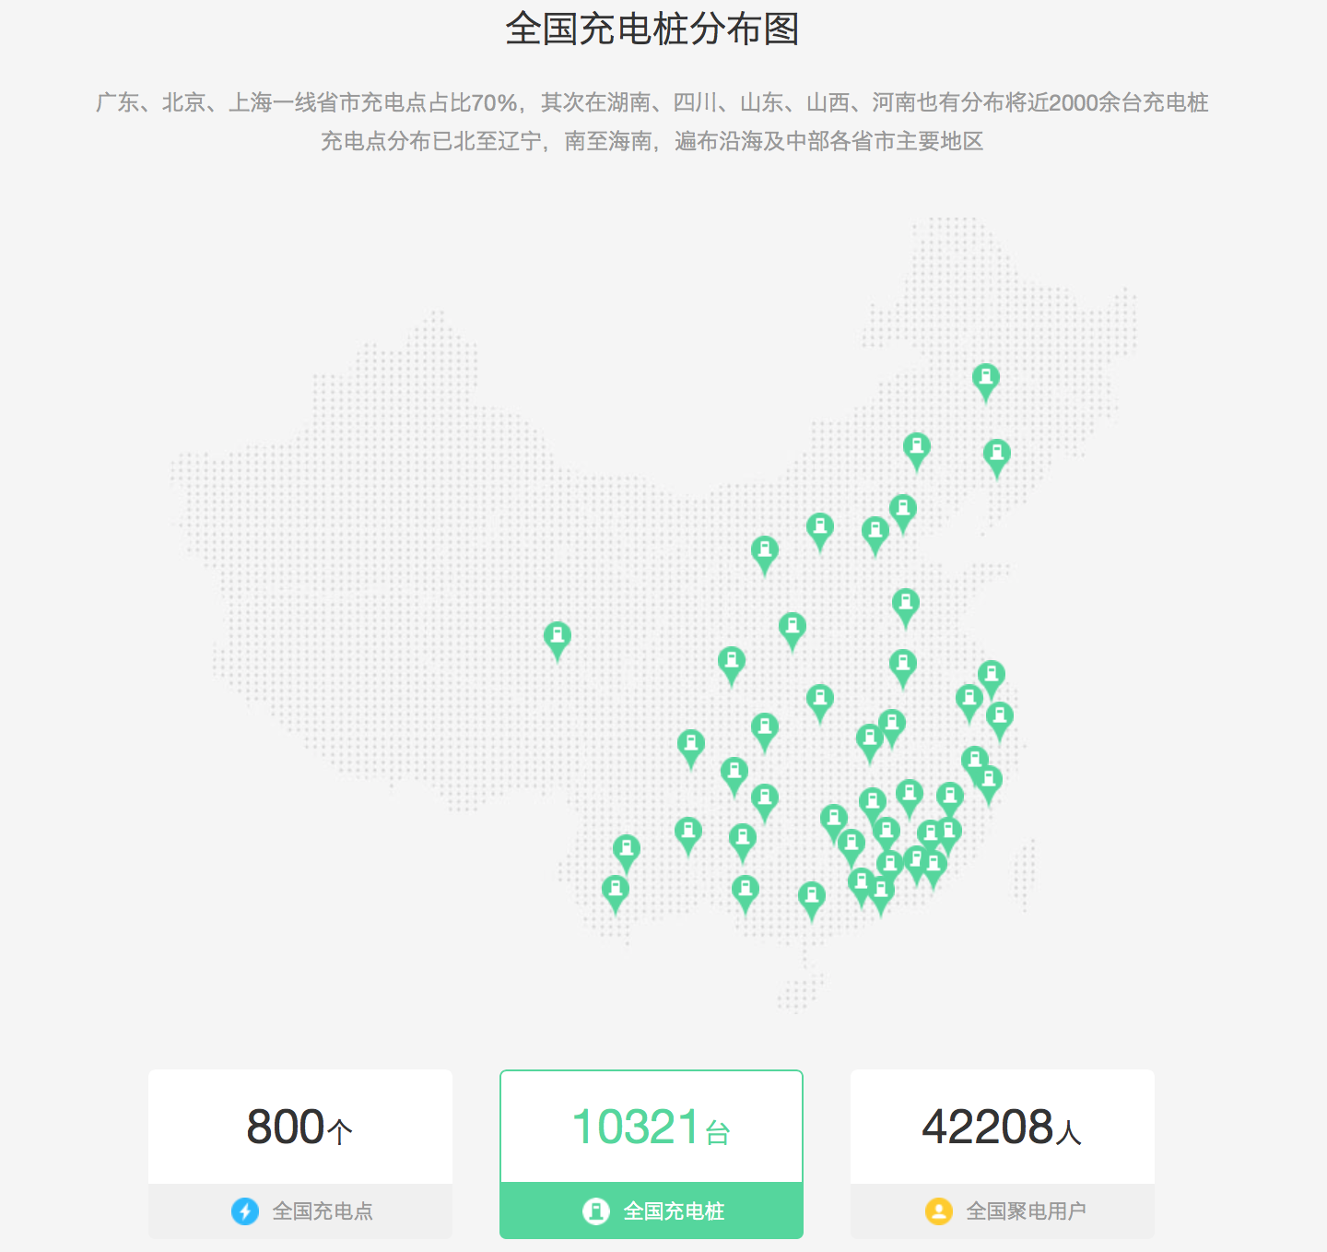
UEEE Netork Technologies Co., Ltd.
800 Charging points
10321 Charging piles
42208 Registered users
Features:
WeChat/ AliPay scan, charge and pay
APP charging reservation
Real-time monitoring, full charge alert

Slide 5


Staff
CEO: Xuefeng Jia 贾雪峰
Nankai University, Bachelor
Tsinghua University, Master
Venture Capitalist background
Co-Founder/Manager: Xiaochen Lu 卢晓晨
Software engineering background
Contact info: 0755-33115321
Customer service: 400-850-5185

Slide 6
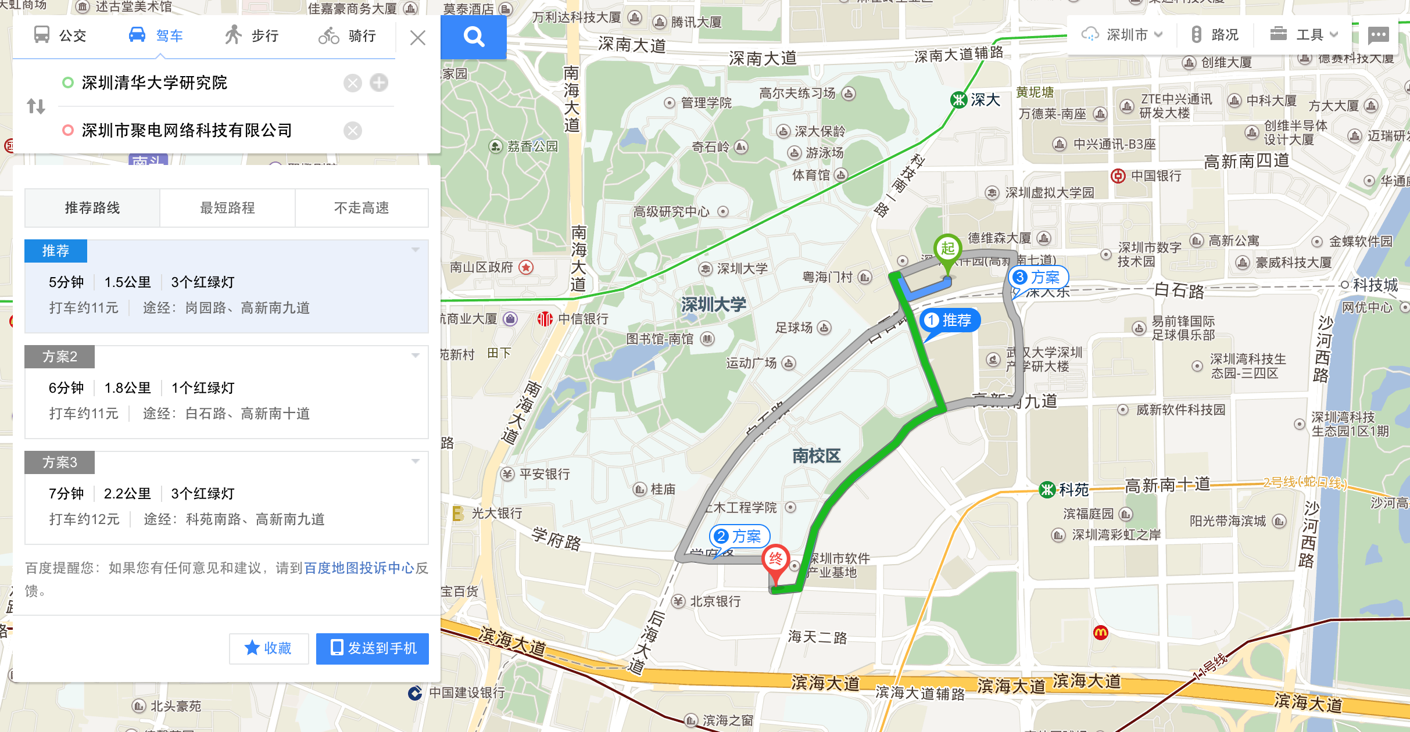
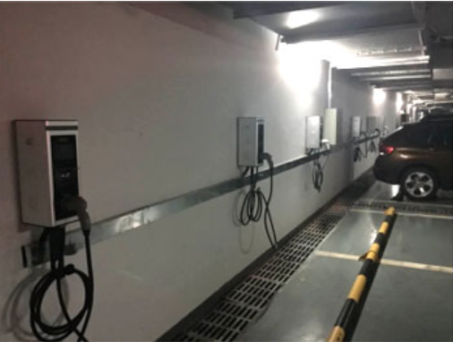
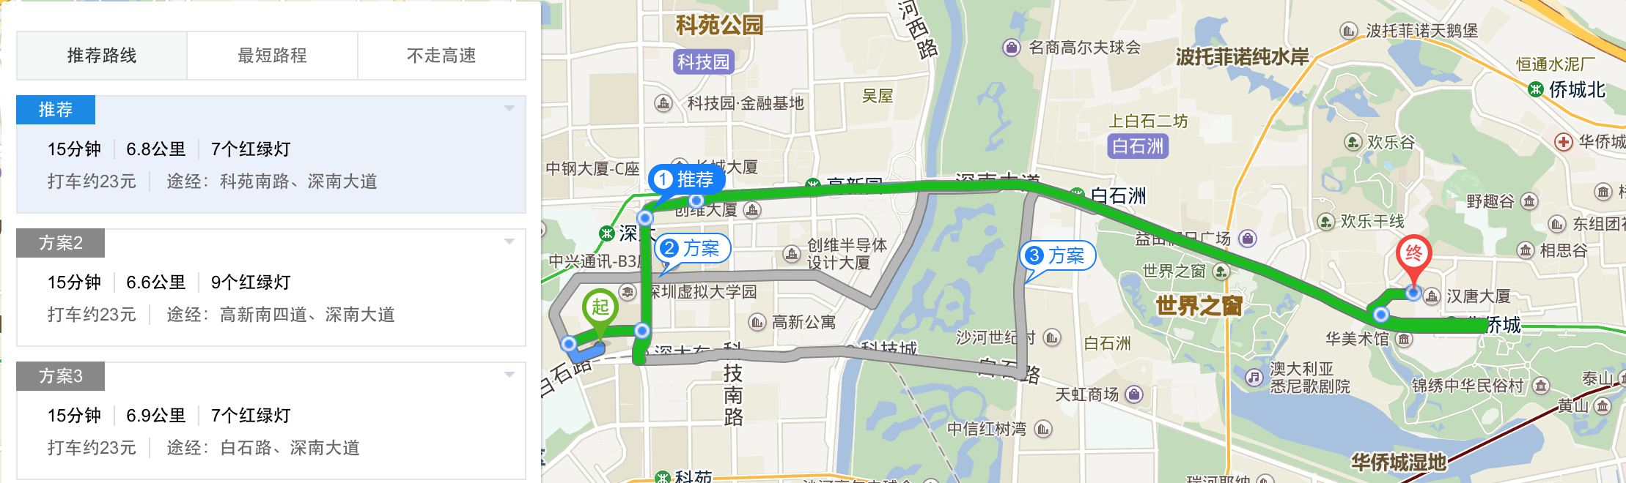
Examples
To UEEE:
Walkable distance (1.5km)
Five minutes driving / twenty minutes walking
To OCT Walmart:
Underground parking
WeChat pay
Fifteen minutes driving (6.8km)

Slide 7
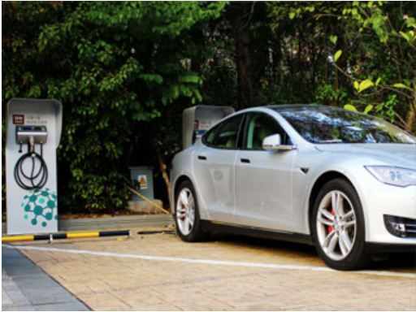
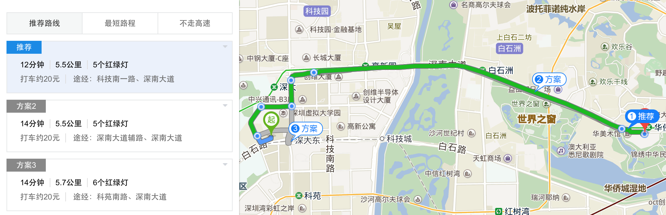
Examples
OCT InterContinental‘s：
Twelve minutes driving (5.5 km)

Slide 8
Comparison
 | UEEE - CN | Charge point - US
Pile types | - AC 3.5, 7.0, 40 kW - DC 15, 30, 45, 60, 90, 120, 180, 240, 360kW - Mini equipment | - CT4000 (all purpose L2 25MPH) - CT25 (private L2 25MPH) - Express (Plus) (250 MPH/15min)
Scale | 10321 charging piles | 37955 charging spots
Target | Mostly public stations located at hotels, CBDs, residential halls, industrial park | Commercial real estate, workplace, family houses (multi-family home service)
Payment method | Mobile app | Charge point card (mobile app maybe)
Service | Scan and charge, remote reservation, charge monitoring, charging pile-EV matching | Cloud service (waitlist, chart analystics, set price), resource management tool (limit charging targets, demand response), NET+
Funding | Angel + round A ¥50M | Up to date $255M

